Slide 1


THE CORE OPERATIONS SUMMIT
2026
AI FOR
OPERATIONS
HOW AI ELIMINATES REWORK, CLOSES GAPS, AND ACCELERATES THE BACK OFFICE
ROB HURTIG
Senior Vice President
Magellan Financial
NICHOLAS CAMACHO
Director Of Digital & Analytics Innovation
Magellan Financial
Notes:
CERTAIN, NOT LOUD (First slide) Below is just my notes.
Purpose: command the room, set seriousness, set love.
Talk track:
“I’m not here because Joe needed a speaker. I’m here because this team is building something real.
And when something is real… you don’t protect it with comfort. You protect it with standards.”
Pause.
“So today, you’re going to feel two things at the same time: You’re going to feel proud… and you’re going to feel challenged.”

Slide 2
LET’S BE CLEAR ABOUT AI
AMPLIFICATION,
NOT REPLACEMENT
Notes:
AI is a tool, like Excel or email. Powerful, but you're still driving
Think of it as a very fast, very tireless assistant who needs direction
The people who thrive with AI aren't the most technical — they're the ones who know their work well enough to point AI in the right direction

Slide 3

WHAT DOES AI ACTUALLY DO WELL?
WHERE AI ADDS LEVERAGE
First Drafts: Emails, Summaries, Reports
Reformatting & Cleanup: Turning messy into organized.
Spotting Gaps: “What am I missing here?”
Pattern Recognition: Inconsistencies, outliers, things that don’t match
Brainstorming: “Give me 10 ways to approach this.”
Notes:
• AI is a rework killer; it catches errors before they become problems
• That thing you'd miss at 4pm on a Friday? AI doesn't get tired
• It's not about AI being smarter than you; it's about AI being faster at the grunt work

Slide 4
DOUBLE, TRIPLE, QUADRUPLE CHECK
THE REWORK PROBLEM
How much time do you spend:
Fixing mistakes that could’ve been caught earlier?
Re-doing something because info was missing?
Chasing down gaps after the fact?
AI can help catch it on the first pass.
Notes:
• • Rework is expensive; time, frustration, credibility
• • AI as a "second set of eyes" that never gets bored
• • Example: paste a draft, ask "what's unclear or missing?" — instant feedback

Slide 5
YOU BRING EXPERTISE,
AI BRINGS SPEED
You know what “right” looks like. AI helps you get there faster.
Notes:
• • This is the key insight: AI amplifies your knowledge
• • Without your expertise, AI is just guessing confidently
• • With your expertise, AI becomes a force multiplier
• • Your judgment stays in the loop; AI handles throughput

Slide 6
HERE ARE SOME EXAMPLES
TASK
WITHOUT AI
WITH AI
Reviewing a long doc
Prepping for a meeting
Answering a tricky question
Miss items when in a rush
Scrambling for context
Hunting through files
“Summarize this and flag inconsistencies”
“What should I know before this call?”
Ask AI, then verify
Notes:
• • These aren't futuristic examples — this is today
• • The pattern: AI does the first 80%, you do the critical 20%
• • You're not outsourcing thinking, you're outsourcing the setup

Slide 7





THE AI MODELS
Open Ai
CHAT GPT
Anthropic
CLAUDE
Google DeepMind
GEMINI
xAI
GROK
Perplexity Ai
PERPLEXITY
Quick and versatile help. The Original
Deep Thinking, Complexity, Nuance
Research, Google Ecosystem
Current Events, Live Analysis
Fast Answers with Sources
Chat GPT is the Swiss army knife of AI models. It helps draft, explain, refine, and explore ideas about anything.
Claude specializes in planning and execution. Excels in anything technical. Opus 4.5 is the best for coding.
Gemini is a Google-native assistant. Knows Google’s tools better than 99% of people. Powerful research and execution tool.
Grok is built for what is happening right now. Excels at tracking live conversations, news, and trends helping you understand context, not just content.
Perplexity is built for verification. It delivers concise answers backed with cited sources. It does the research across the web for you.
Notes:
• • These all do similar things, but each has a personality
• • ChatGPT: most popular, great all-rounder, tons of integrations
• • Claude: handles complex reasoning, better with long documents and sensitive topics
• • Gemini: built into Google Workspace — if you live in Gmail/Docs/Sheets, it's seamless
• • Perplexity: when you need facts with citations, not a conversation
• • Start with one, learn its quirks, expand from there

Slide 8
EFFICIENCY STEMS FROM AUTOMATION
WHEN AI MEETS AUTOMATION
Notes:
• • Automation has been around for years. it's powerful but rigid
• • AI adds flexibility. it can interpret, summarize, decide
• • Example: an email comes in → automation routes it → AI drafts a response → you approve
• • You don't need to build these systems yourself but knowing your process is step one

Slide 9
WHEN AI MEETS AUTOMATION
LET’S TALK AUTOMATION
AI Without Automation: Helpful, but you can only focus on one thing at a time.
Automation without AI: Fast, but can take a while to setup. Cannot give automation context.
AI with Automation: Fast, contextual, and can close gaps before things fall through the cracks.
Know how to articulate your issue/request with what you use.
Notes:
• • This is where back-office ops gets transformed
• • The goal isn't replacing people it's eliminating the gaps and delays
• • When you know your process, you can describe it. When you can describe it, it can be optimized.

Slide 10
WHEN AI MEETS AUTOMATION
EXAMPLE 1
Context: You use Google sheets as your main place to keep all your leads.
Problem: All your leads are in one giant list and you want to automate them to a live summary tab.
How to Ask AI: Hey Chat, in Google sheets, I want to make a live summary tab with my data. Can you walk me through this? What did you need from me?
Notes:
• • This is where back-office ops gets transformed
• • The goal isn't replacing people it's eliminating the gaps and delays
• • When you know your process, you can describe it. When you can describe it, it can be optimized

Slide 11
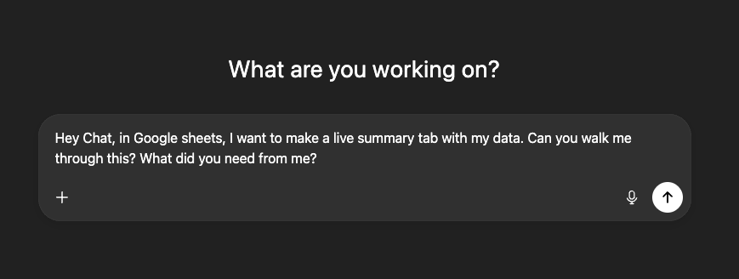
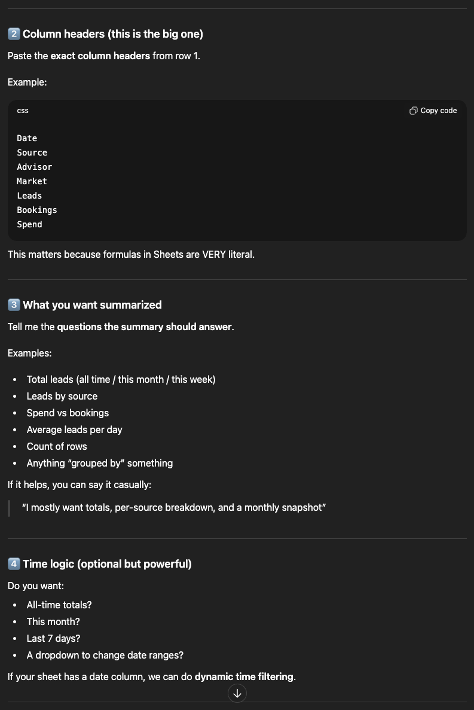
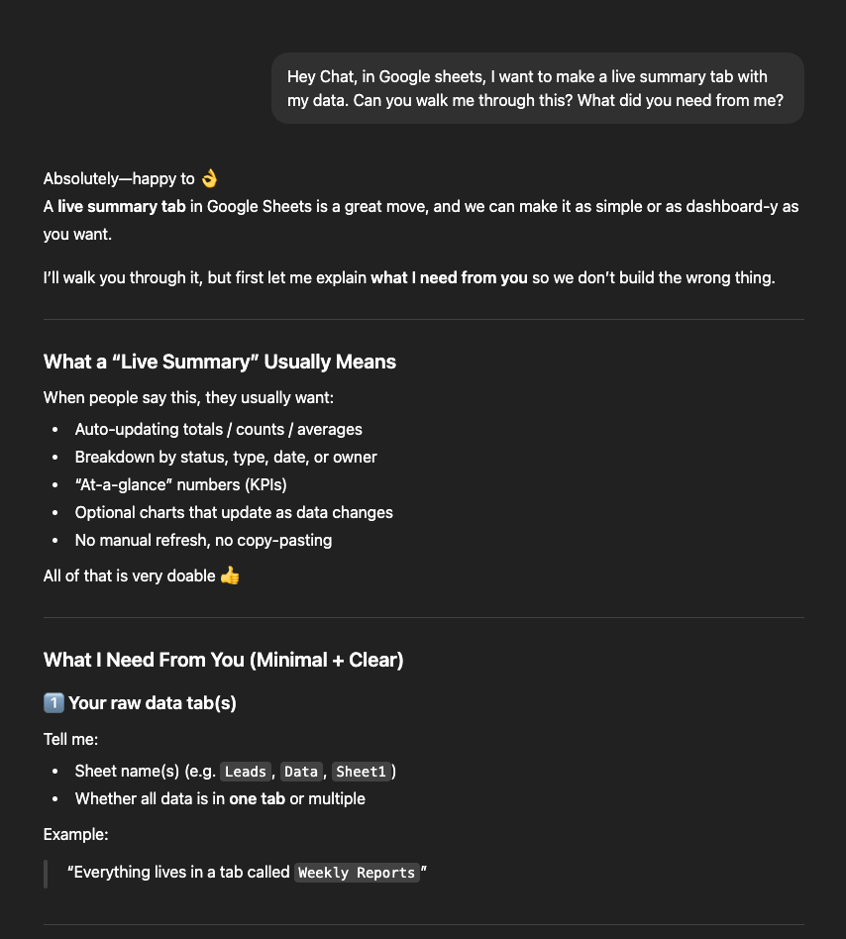
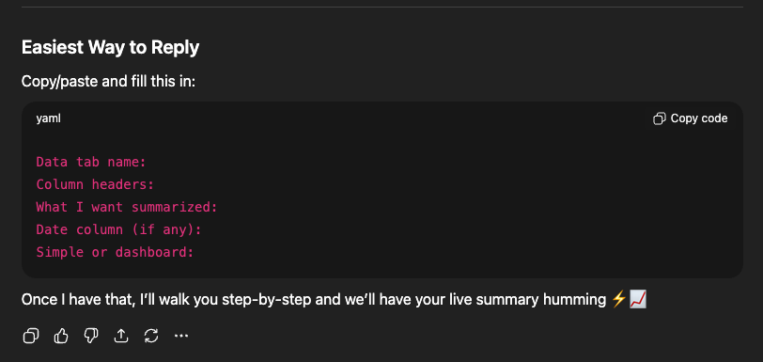
Notes:
THIS IS CONTEXT!

Slide 12
AUTOMATING FROM PROGRAM TO PROGRAM
WE TALKED AI.
LET’S TALK AUTOMATION.

Slide 13

AUTOMATING APPLICATIONS
Zapier
Make
N8N
Learning Curve: Very Easy
Meant for non-technical individuals to help automate data across platforms. Avoids code speak altogether.
Learning Curve: Easy
Meant for non-technical individuals to help automate data across platforms with more robust functionality.
Learning Curve: Hard
Meant for technical individuals or developers who are experienced in data movement and manipulation via code.

Slide 14
WHEN AI MEETS AUTOMATION
EXAMPLE 2
Context: You still use Google Sheets as your main lead list, Wealth Box. You have NOT bought Zapier yet.
Problem: You are tired of manually entering your leads into your CRM (Wealth Box).
How to Ask AI: Hey Chat, all my data lives in Google sheets. How can I automatically upload leads to Wealthbox?
Notes:
• • This is where back-office ops gets transformed
• • The goal isn't replacing people — it's eliminating the gaps and delays
• • When you know your process, you can describe it. When you can describe it, it can be optimized

Slide 15
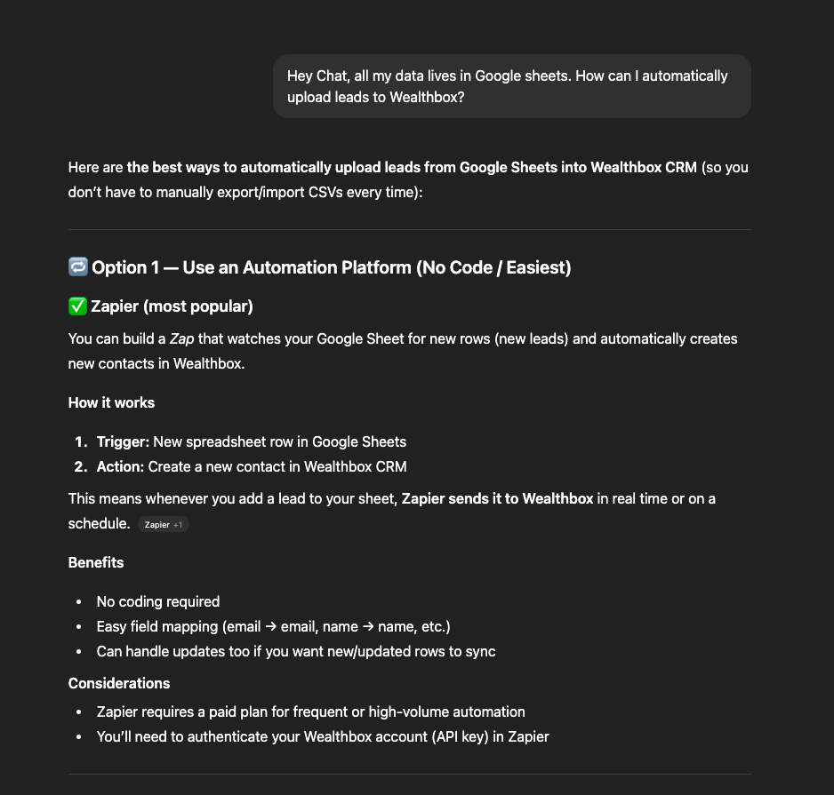
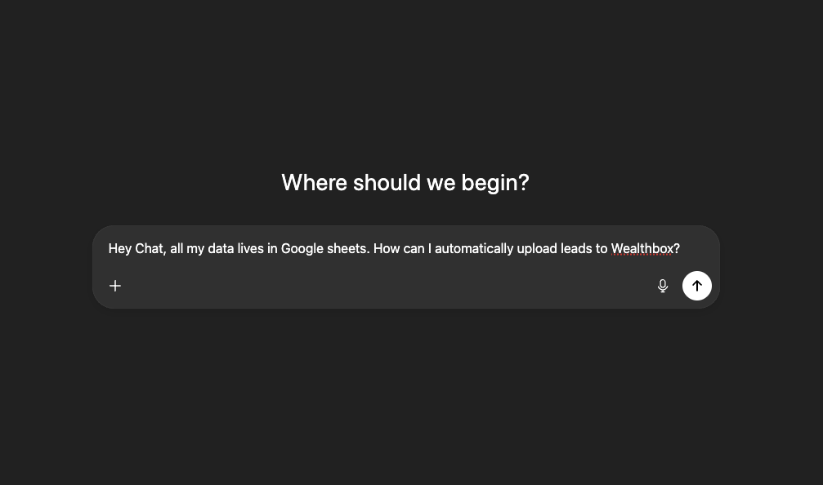

Slide 16
WHEN AI MEETS AUTOMATION
EXAMPLE 2 (UPDATED)
Context: You still use Google Sheets as your main lead list, Wealth Box AND Zapier.
Problem: You are tired of manually entering your leads into your CRM (Wealth Box).
How to Ask AI: Hey Chat, all my data lives in Google sheets. How can I automatically upload leads to Wealthbox? How do I do this in Zapier?

Slide 17
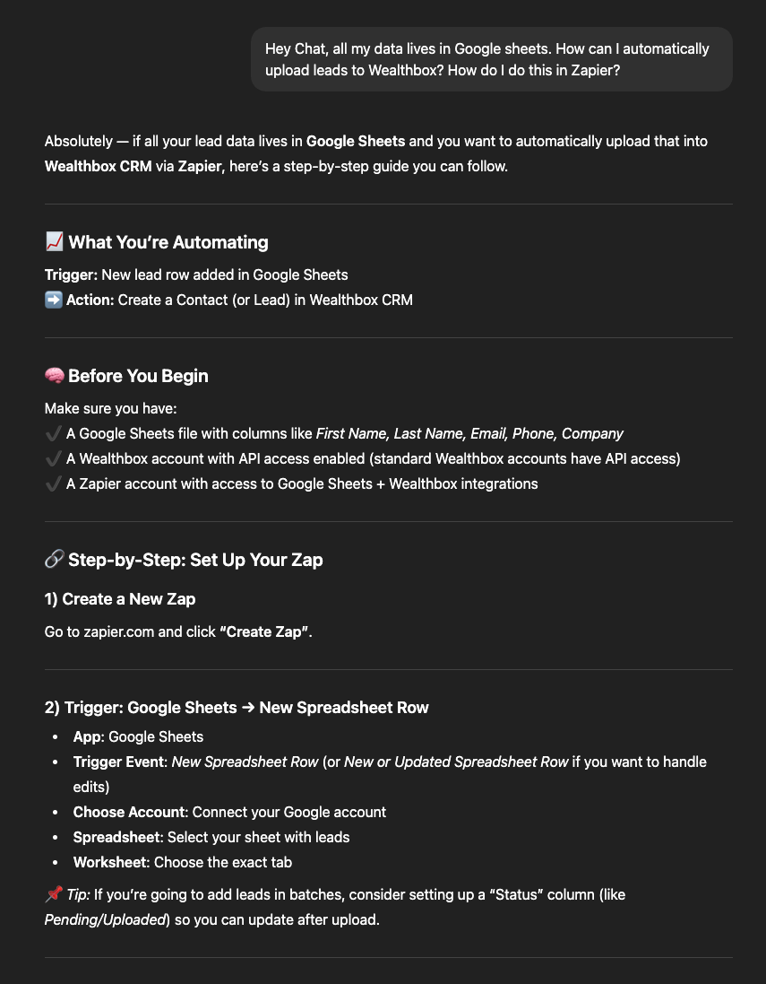
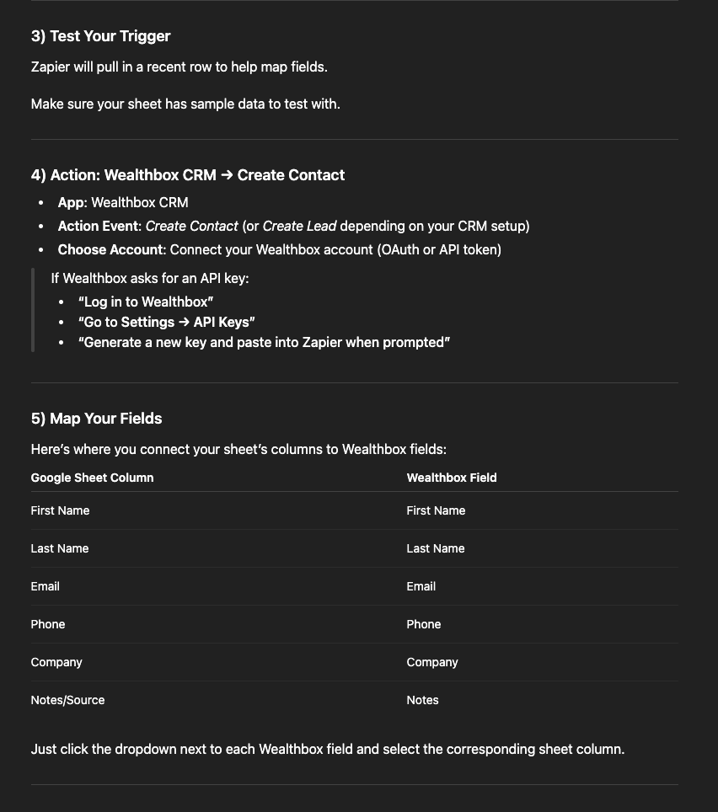

Slide 18
YOU DON’T NEED TO BE TECHNICAL
KNOW YOUR PROCESS
What triggers the work?
What steps happen?
Where do things get stuck or fall through?
What does “done right” look like?
Do you know your programs well enough to explain it to a 10-year-old?
Notes:
• • Technical people can build it, but you know what needs to be built
• • AI and automation are just ways to execute what you already know

Slide 19
IT’S TIME TO ADJUST THE MINDSET
AS POWERFUL AS IT IS.
AI STILL NEEDS A DRIVER.
Notes:
There's a lot of fear and hype — let's cut through it
AI is a tool, like Excel or email. Powerful, but you're still driving
Think of it as a very fast, very tireless assistant who needs direction
The people who thrive with AI aren't the most technical — they're the ones who know their work well enough to point AI in the right direction

Slide 20
START SMALL
START NOW
PICK ONE THING. ASK AI. SEE WHAT HAPPENS.

Slide 21
QUESTIONS?

