Slide 1




THE CORE OPERATIONS SUMMIT
2025
THE CORE OPERATIONS SUMMIT
2026
FOUNDATIONS POWER PORTAL
TURNING THE PORTAL INTO A PRODUCTIVITY MACHINE
JOSH COOKSEY
Chief Operating Officer
Foundations
AMBER NAMITZ
Manager of Trading Operations
Foundations

Slide 2
HOW THE PORTAL FITS INTO YOUR BUSINESS TODAY
Shared operating hub between Magellan Financial and Foundations
Centralizes data, communication, resources, and execution
Designed to support growth through clarity and consistency
An early-stage platform built with long-term evolution in mind
Notes:
Slide 1: Foundations Power Portal
How the Portal Fits into Your Business Today
- Shared operating hub between Magellan Financial and Foundations
- Centralizes data, communication, resources, and execution
- Designed to support growth through clarity and consistency
- An early-stage platform built with long-term evolution in mind

Slide 3
GROWTH IS ONLY AS STRONG AS THE SYSTEMS BENEATH IT
As firms grow, small inefficiencies become larger problems
Manual back-and-forth increases with volume
Minor gaps compound quickly across accounts and workflows
Systems create structural reliability as complexity increases
Notes:
Slide 2: Growth Is Only as Strong as the Systems Beneath It
- As firms grow, small inefficiencies become larger problems
- Manual back-and-forth increases with volume
- Minor gaps compound quickly across accounts and workflows
- Systems create structural reliability as complexity increases

Slide 4

HOW THIS COMES TO LIFE IN THE PORTAL
New features and how to move faster through daily workflows
Where firms commonly get stuck and how to avoid it
Tools you may not be using (but should be)
What’s coming next to make your life easier
Notes:
Slide 3: How This Comes to Life in the Portal
- New features and how to move faster through daily workflows
- Where firms commonly get stuck and how to avoid it
- Tools you may not be using (but should be)
- What’s coming next to make your life easier

Slide 5
STREAMLINED WORKFLOWS
How to handle day-to-day execution without extra back-and-forth
Practical habits that save time immediately
What’s new in the workflow and how it fits into your workflow
Notes:
Slide 4: Streamlined Workflows
How to handle day-to-day execution without extra back-and-forth
Practical habits that save time immediately
What’s new in the Portal and how it fits into your workflow

Slide 6
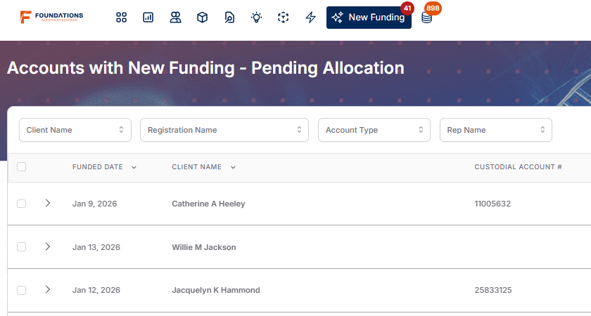
NEW FUNDING PAGE
Purpose: Alerts you to new funding that needs to be allocated. In a future state, the majority of received funding will need to be invested or restricted by you, giving you more visibility and control over the management of your accounts.
Bugs Bunny
012345678
Wile E. Coyote
Yosemite Sam
876543210
Notes:
Purpose: Alerts you to new funding that needs to be allocated. In a future state, the majority of received funding will need to be invested or restricted by you, giving you more visibility and control over the management of your accounts.

Slide 7
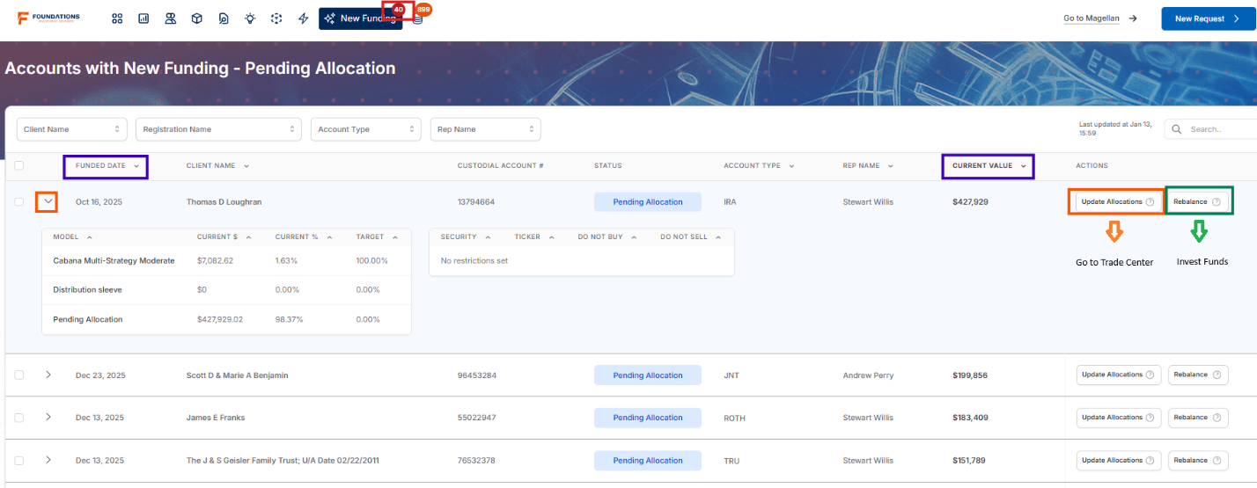
NEW FUNDING PAGE
BASIC USAGE AND NAVIGATION
Number Badge: how many accounts that need investment instructions
Useful Fields to Sort by:
Funded Date
Current Value
Review Accounts
View account allocation snapshot
Update Allocations or Restrictions
Rebalance into current models
Bugs Bunny
Elmer Fudd
Daffy Duck
Elmer Fudd
Wile E. Coyote
Porky Pig
Yosemite Sam
Porky Pig
Notes:
Number Badge: how many accounts that need investment instructions
Useful Fields to Sort by:
Funded Date
Current Value
Review Accounts
View account allocation snapshot
Update Allocations or Restrictions
Rebalance into current models

Slide 8
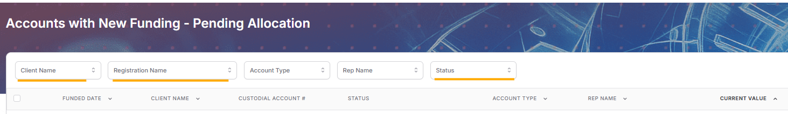
NEW FUNDING PAGE
BASIC USAGE AND NAVIGATION
Client Name – allows you to review a household
Registration Name – pull up specific account from the filter, you can also search the account number in the search bar
Status – allows you to view either just accounts that need rebalance or just accounts that do not have model selections
Together, these filter views as well as the Sort function, can help with bulk clean up on the New Funding page
Notes:
Client Name – allows you to review a household
Registration Name – pull up specific account from the filter, you can also search the account number in the search bar
Status – allows you to view either just accounts that need rebalance or just accounts that do not have model selections
Together, these filter views as well as the Sort function, can help with bulk clean up on the New Funding page

Slide 9
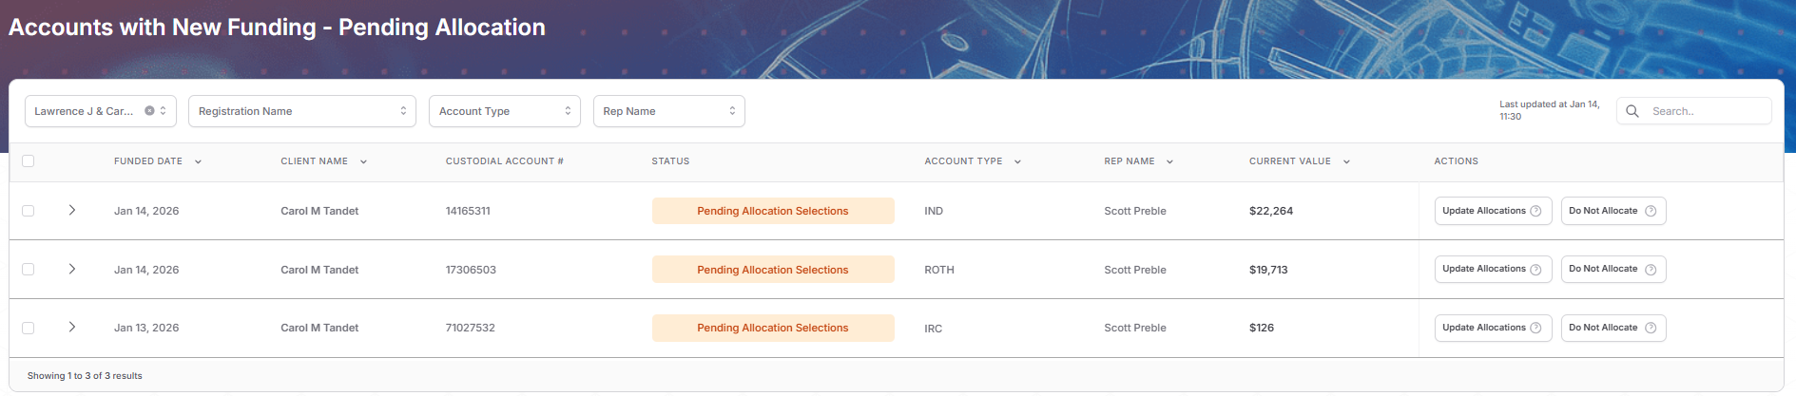
NEW FUNDING PAGE
ADVANCED ACCOUNT MANAGEMENT TIPS
Pending Allocation Selections Status – accounts that do not have managed models assigned and have received new funding
Add a client name filter to see if an entire household has funded
If ready to allocate, update allocations on each account
If not, you can group select and bulk “Do Not Allocate”, removing the accounts from your new funding queue (they will still be visible on the Pending Model Assignment page) - feature may not be live yet
Bugs Bunny
012345678
Elmer Fudd
Bugs Bunny
923462837
Elmer Fudd
Bugs Bunny
239467298
Elmer Fudd
Notes:
Slide 8: New Funding Page – Advanced Account Management Tips
Pending Allocation Status – accounts that do not have managed models assigned and have received new funding
Add a client name filter to see if an entire household has funded
If ready to allocate, Update Allocations on each account
If not, you can group select and bulk “Do Not Allocate”, removing the accounts from your new funding queue (they will still be visible on the Pending Model Assignment page)- feature may not be live yet

Slide 10
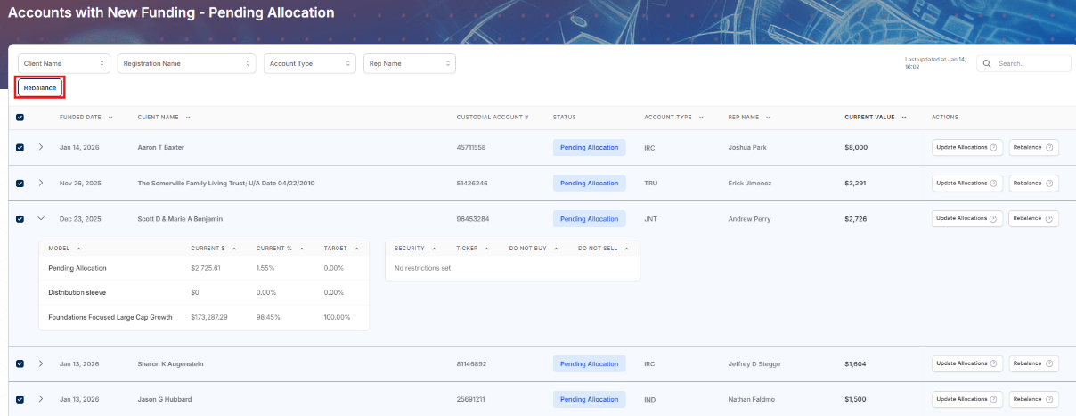
NEW FUNDING PAGE
ADVANCED ACCOUNT MANAGEMENT TIPS
Pending Allocation Status – accounts with managed models and new funds that are ready for investment
Sort by dollar value to find lower value recurring deposits, bulk rebalance to save time keeping the queue clean and cash invested
Bugs Bunny
012345678
Elmer Fudd
Foghorn Leghorn
123456789
Porky Pig
Yosemite Sam
234567890
Porky Pig
Daffy Duck
345678901
Porky Pig
Tweety Bird
456789012
Elmer Fudd
Notes:
Pending Rebalance Status – accounts with managed models and new funds that are ready for investment
Sort by dollar value to find lower value recurring deposits, bulk rebalance to save time keeping the queue clean and cash invested

Slide 11
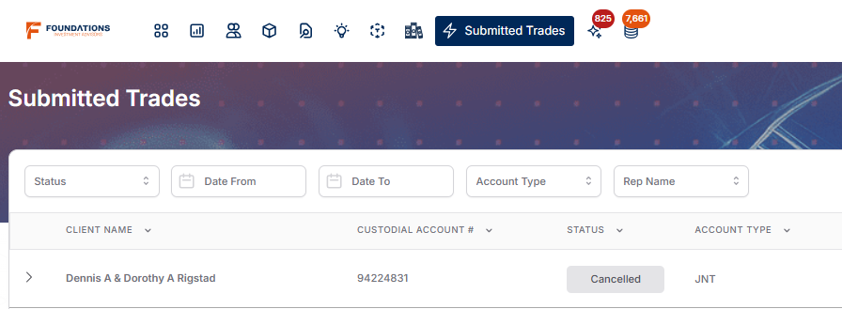
SUBMITTED TRADES PAGE
Purpose: Allows you to review your submitted trades to ensure your instructions were executed without issue
Traded accounts will stay on your page for 30 days
Can dismiss manually once you’ve confirmed trades proceeded as intended
Bugs Bunny
012345678
Notes:
Slide 9: Submitted Trades Page
Purpose: Allows you to review your submitted trades to ensure your instructions were executed without issue
Traded accounts will stay on your page for 30 days
Can dismiss manually once you’ve confirmed trades proceeded as intended

Slide 12
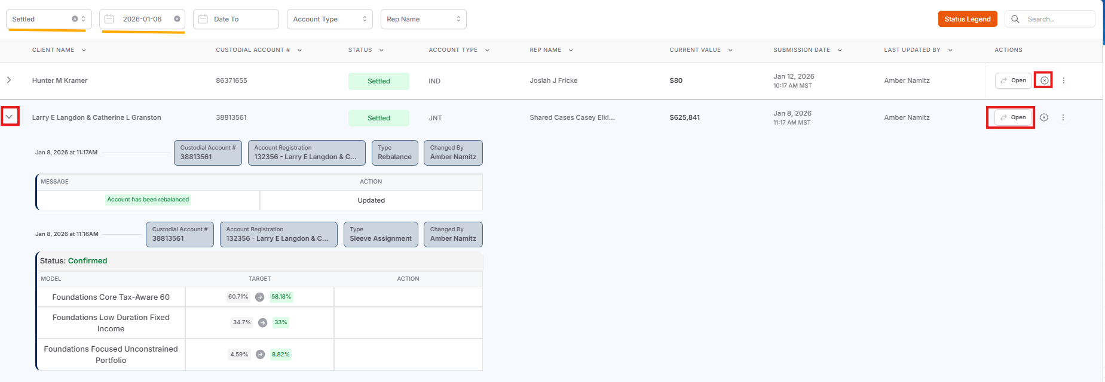
SUBMITTED TRADES PAGE
BASIC NAVIGATION
Review: view submitted instructions and Open trade center for additional context
Filters
Date Range – allows you to review trades by day or week
Status– look for completed trades and dismiss or isolate statuses requiring additional review
Bugs Bunny
234526257
Elmer Fudd
Elmer Fudd
Daffy Duck
123456789
Elmer Fudd
Elmer Fudd
Daffy Duck
12345 - Daffy Duck
Elmer Fudd
12345678
Elmer Fudd
12345 - Daffy Duck
Notes:
Slide 10: Submitted Trades Page – Basic Navigation
Review: view submitted instructions and Open trade center for additional context
Filters
Date Range – allows you to review trades by day or week
Status– look for completed trades and dismiss or isolate statuses requiring additional review

Slide 13
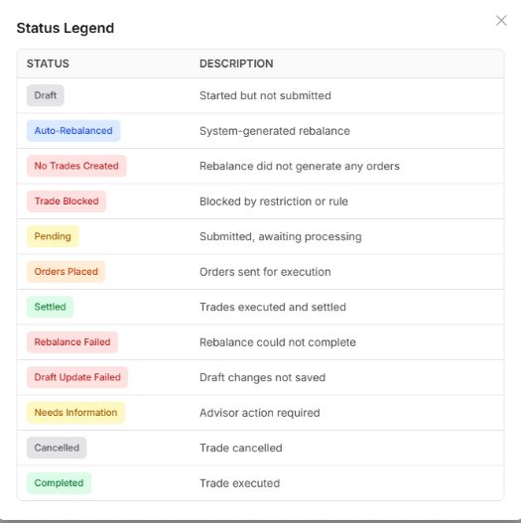
SUBMITTED TRADES PAGE
STATUSES REQUIRING ADDITIONAL REVIEW
Draft
No Trades Created
Rebalance Failed
Needs Information
Bugs Bunny
012345678
Notes:
SUBMITTED TRADES PAGE
STATUSES REQUIRING ADDITIONAL REVIEW
Draft
No Trades Created
Rebalance Failed
Needs Information

Slide 14
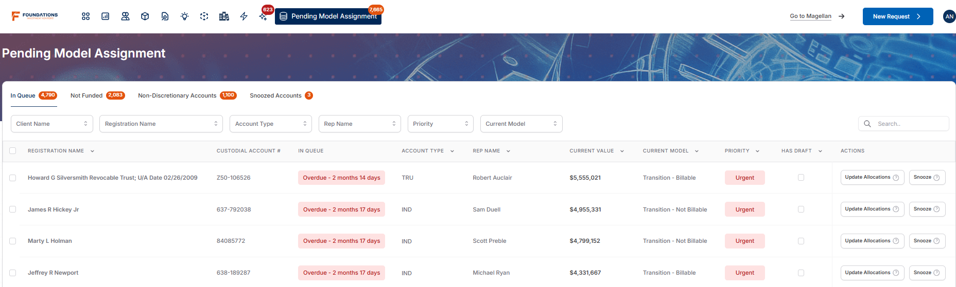
WHAT’S NEW
PENDING MODEL ASSIGNMENT PAGE
Purpose:
Alerts you to funded accounts without model assignments
Lists not funded accounts without model assignments so you can see what is open and pending
Allows you to create reminders to allocate at a future date
Still in Development, more functionality and custom alerts coming soon!
Bugs Bunny
0123456781
Elmer Fudd
Daffy Duck
1234567890
Elmer Fudd
Wile E. Coyote
8736265567
Porky Pig
Yosemite Sam
0987237936
Porky Pig
Notes:
Slide 12: What’s New: Pending Model Assignment Page
Purpose
Alerts you to funded accounts without model assignments
Lists not funded accounts without model assignments so you can see what is open and pending
Allows you to create reminders to allocate at a future date
Still in Development, more functionality and custom alerts coming soon!

Slide 15
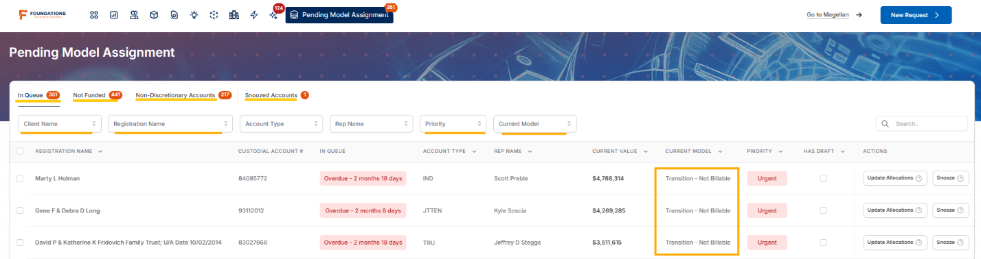
WHAT’S NEW
PENDING MODEL ASSIGNMENT PAGE: BASIC USAGE AND NAVIGATION
Filters similar to New Funding Page
Split page views for Funded and Not Funded Transition accounts, Non-Discretionary, and Snoozed
Priority dependent on how long the account has been open (Still in Development)
Bugs Bunny
0123456781
Elmer Fudd
Daffy Duck
9837429377
Porky Pig
Wile E. Coyote
2323337772
Elmer Fudd
Notes:
Slide 13: Pending Model Assignment Page – Basic Usage and Navigation
Filters similar to New Funding Page
Split page views for Funded and Not Funded Transition accounts, Non-Discretionary, and Snoozed
Priority dependent on how long the account has been open (Still in Development)

Slide 16
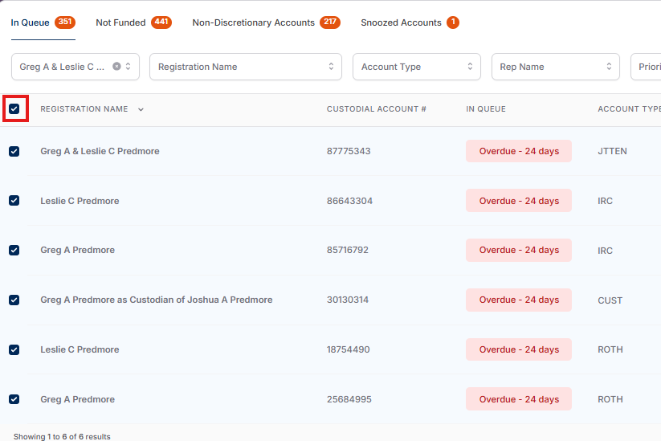
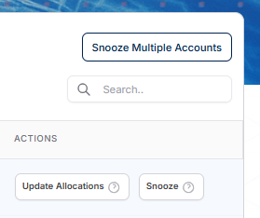
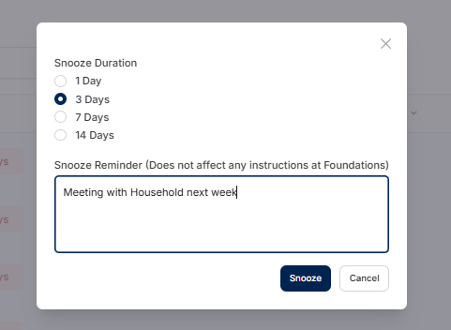
BULK SNOOZE
Bugs Bunny
0123456781
Foghorn Leghorn
9372492372
Marvin the Martian
2387462836
Wile E. Coyote
2398423472
Daffy Duck
7948773777
Tweety Bird
3276482364
Notes:
Slide 13: Bulk Snooze

Slide 17
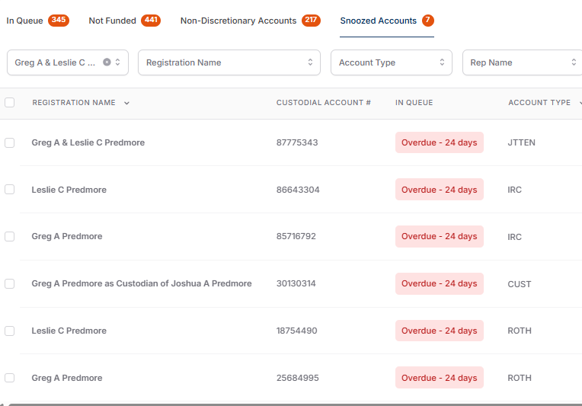
BULK SNOOZE
Bugs Bunny
0123456781
Foghorn Leghorn
9372492372
Marvin the Martian
2387462836
Wile E. Coyote
2398423472
Daffy Duck
7948773777
Tweety Bird
3276482364
Notes:
Slide 13: Bulk Snooze

Slide 18
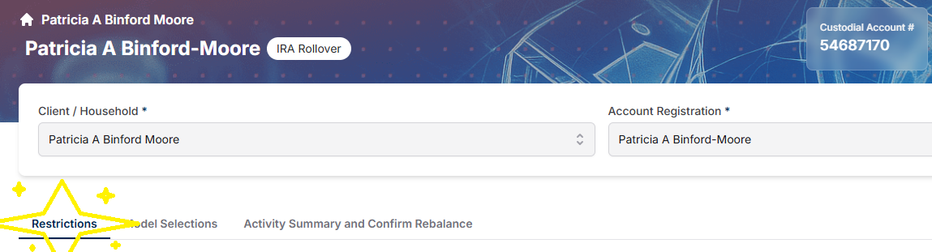
WHAT’S NEW
UPDATED RESTRICTION FUNCTIONALITY
Newly updated Restrictions page
Increased visibility and control in setting and reviewing restrictions
Manage account restrictions immediately without back and forth of a Lift/Modify request
Bugs Bunny
0123456781
Bugs Bunny
Bugs Bunny
Notes:
Slide 15: What’s New: Updated Restriction Functionality
Newly updated Restrictions page
Increased visibility and control in setting and reviewing restrictions
Manage account restrictions immediately without back and forth of a Lift/Modify request

Slide 19
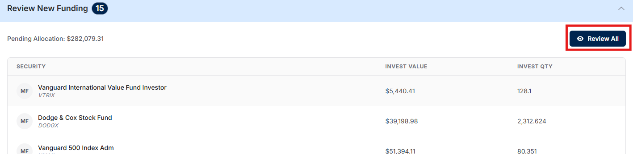
WHAT’S NEW
RESTRICTING ASSETS FROM THE REVIEW NEW FUNDING SLEEVE
Notes:
Slide 16: Restricting Assets from the Review New Funding sleeve

Slide 20
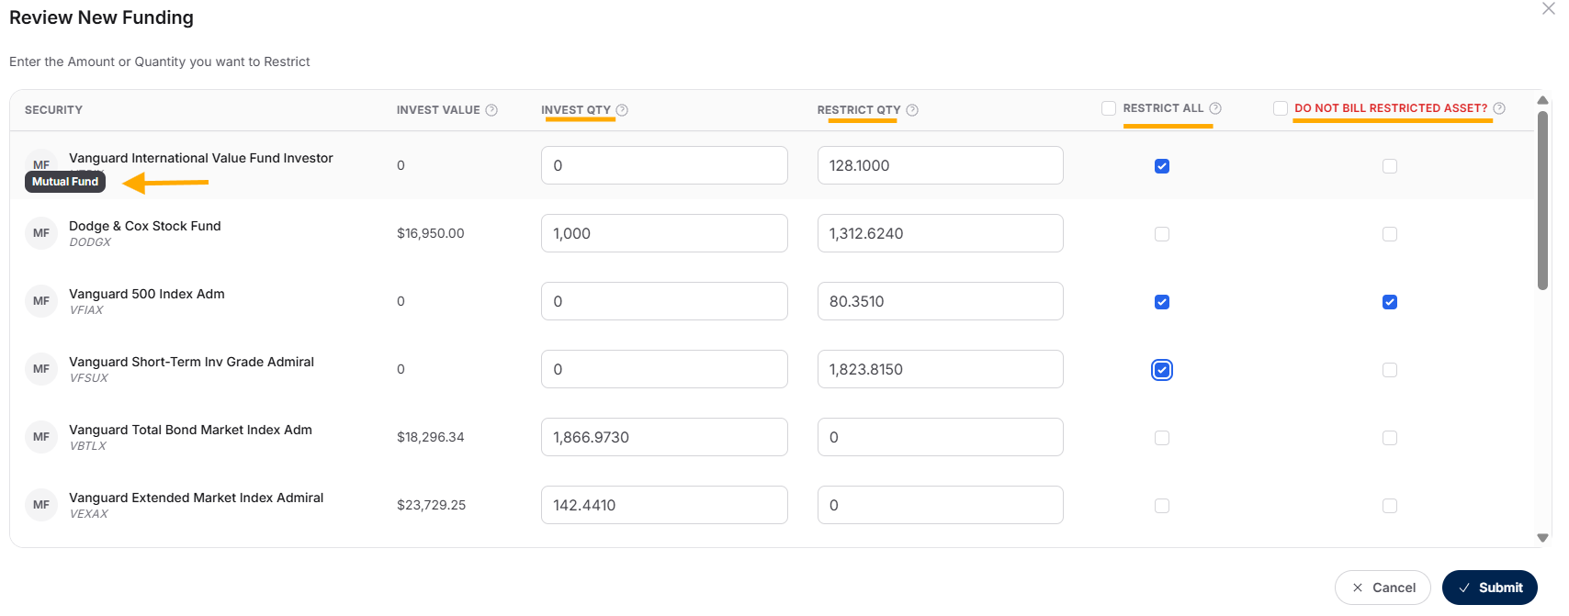
WHAT’S NEW
RESTRICTING ASSETS FROM THE REVIEW NEW FUNDING SLEEVE
Notes:
Slide 16: Restricting Assets from the Review New Funding sleeve

Slide 21
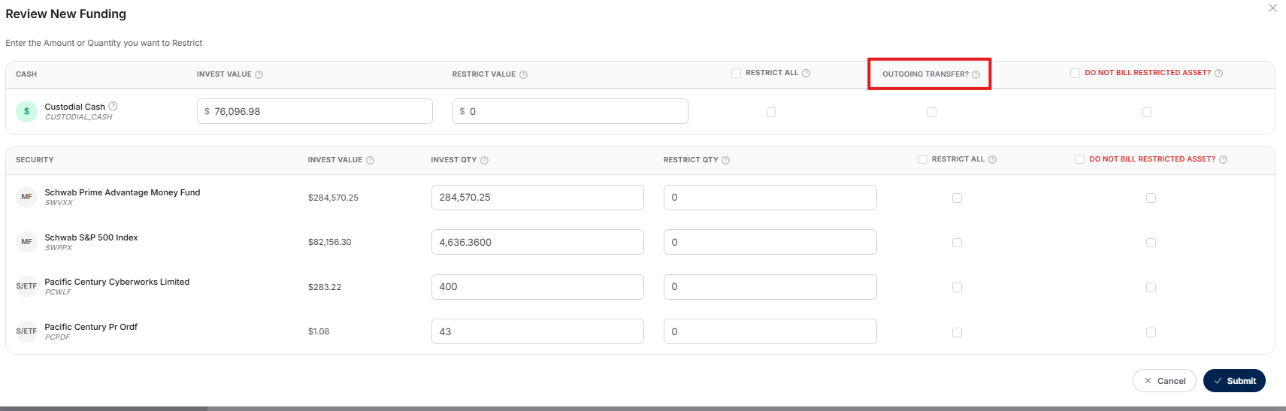
WHAT’S NEW
RESTRICTING ASSETS FROM THE REVIEW NEW FUNDING SLEEVE
Cash will be listed separately at the top of the asset list because it has an extra restriction option: Outgoing Transfer
Please select Outgoing Transfer for the cash redirection if you expect the funds to transfer out, whether to annuity, distribution to client, or journal to other accounts.

Slide 22
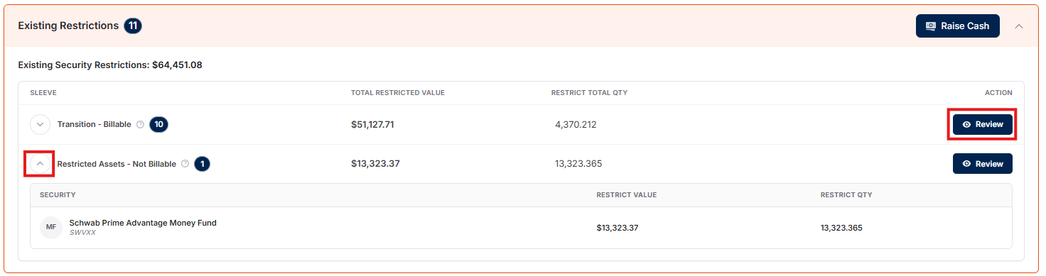
WHAT’S NEW
UNRESTRICTING ASSETS FROM RESTRICTED SLEEVES
Notes:
Slide 17: Unrestricting Assets from Restricted Sleeves

Slide 23
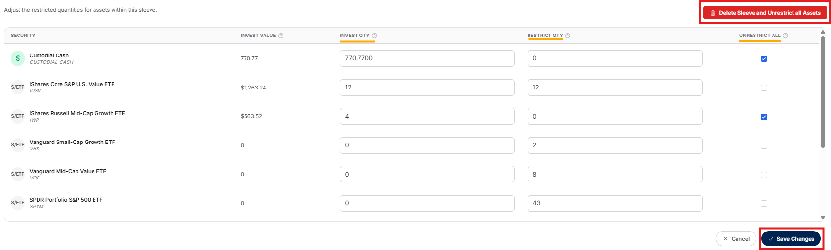
WHAT’S NEW
UNRESTRICTING ASSETS FROM RESTRICTED SLEEVES
Notes:
Slide 17: Unrestricting Assets from Restricted Sleeves

Slide 24
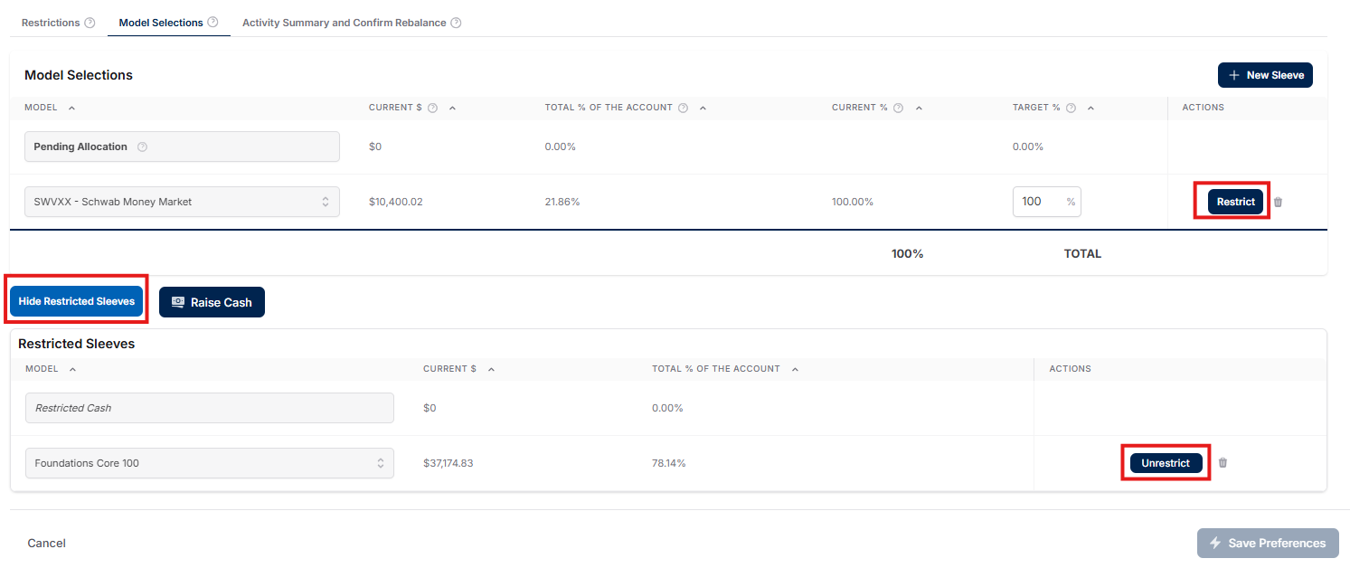
WHAT’S NEW
UPDATES TO MODEL SELECTIONS TAB
Notes:
Slide 18: Updates to Model Selections Tab

Slide 25
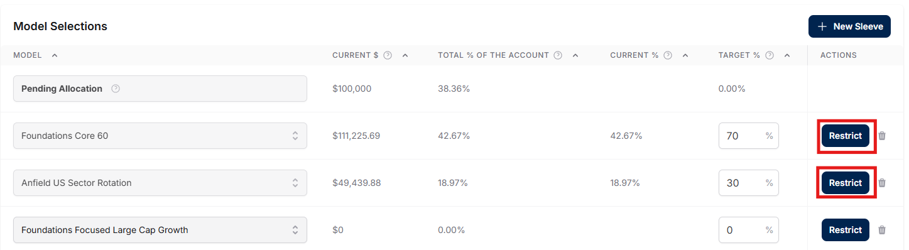
ADVANCED USE CASES
CREATING A ONE-TIME ALLOCATION TO A MODEL
Notes:
Slide 19: Advanced Use Cases: Creating a one-time allocation to a model

Slide 26
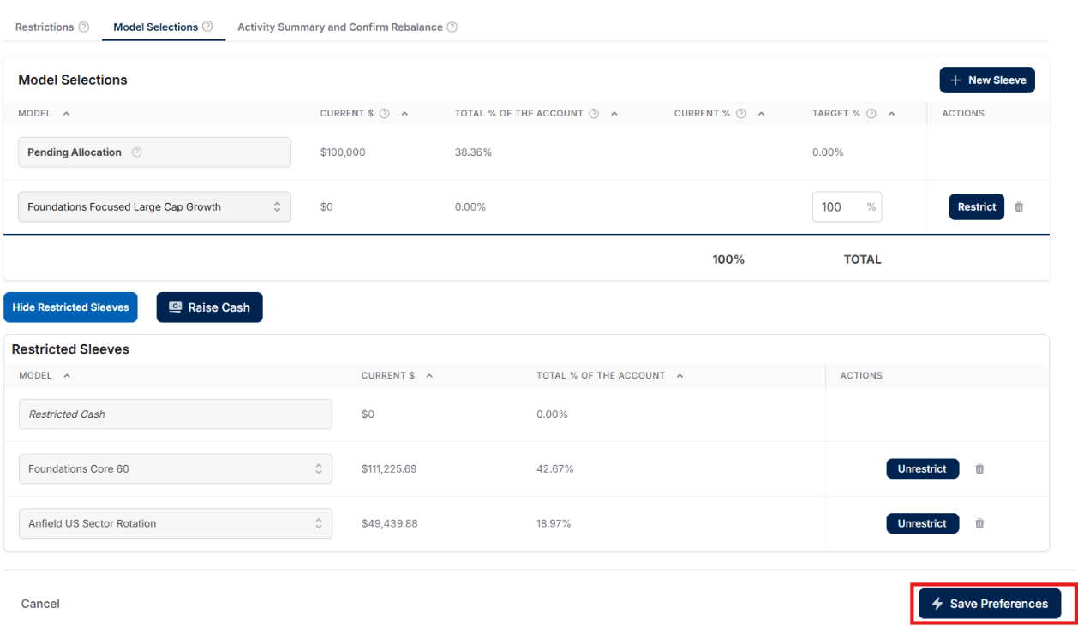
ADVANCED USE CASES
CREATING A ONE-TIME ALLOCATION TO A MODEL
Notes:
Slide 19: Advanced Use Cases: Creating a one-time allocation to a model

Slide 27
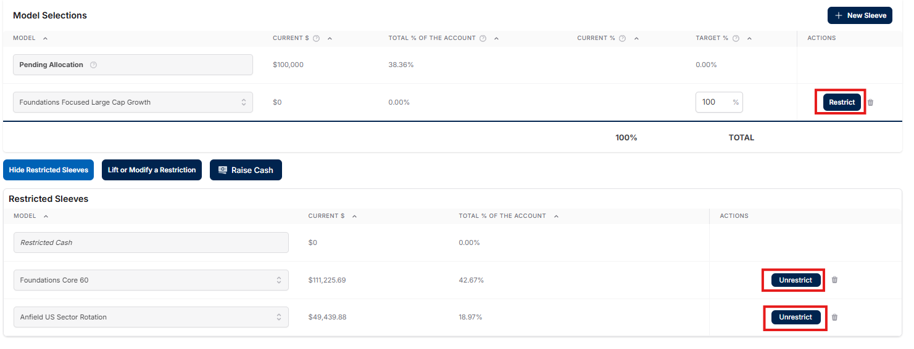
ADVANCED USE CASES
CREATING A ONE-TIME ALLOCATION TO A MODEL
Notes:
Slide 20: Advanced Use Cases: Creating a one-time allocation to a model, pt. 2

Slide 28
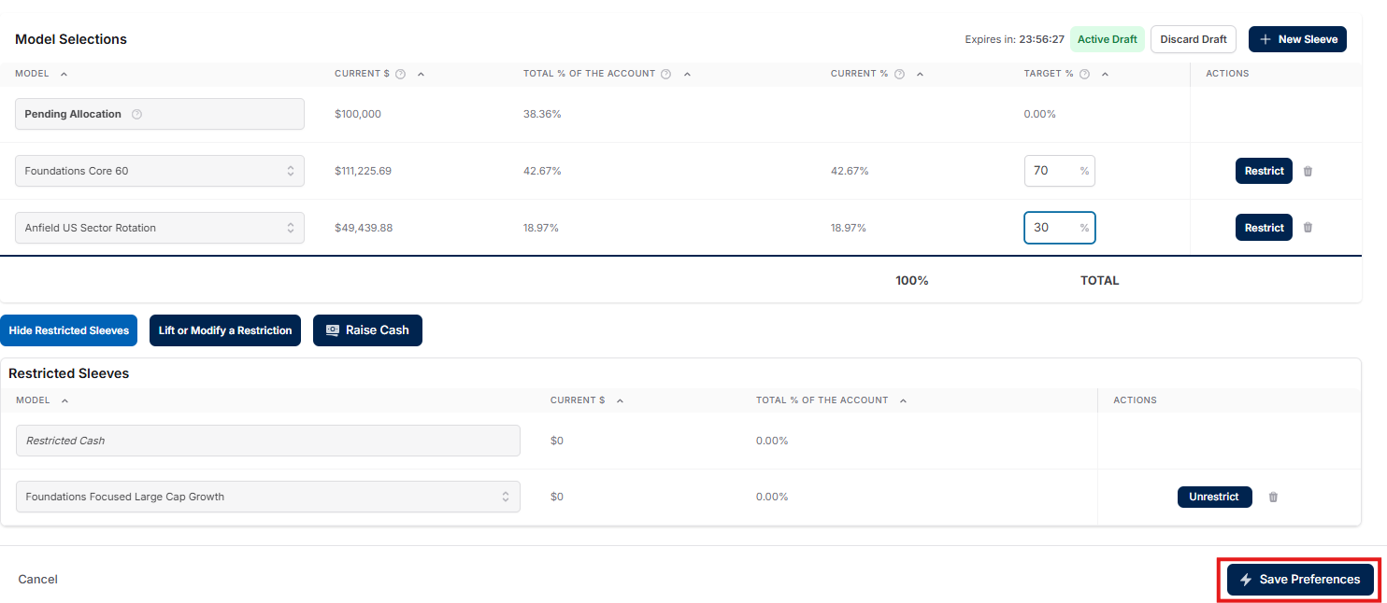
ADVANCED USE CASES
CREATING A ONE-TIME ALLOCATION TO A MODEL
Notes:
Slide 20: Advanced Use Cases: Creating a one-time allocation to a model, pt. 2

Slide 29
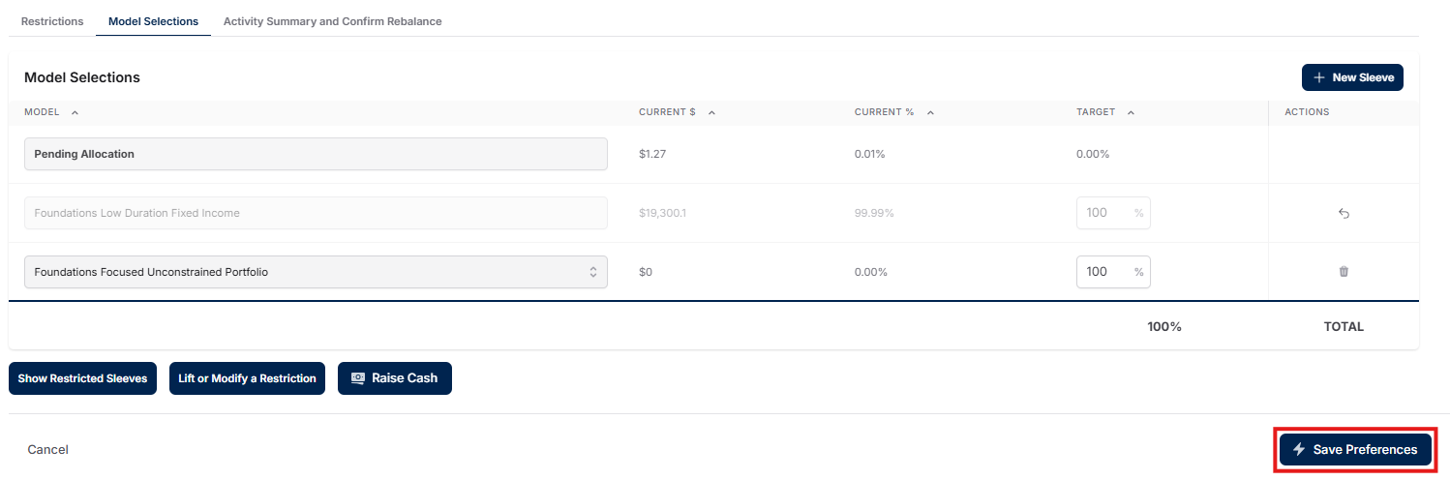
ADVANCED USE CASES
RESTRICTING ASSETS FROM A MODEL
Notes:
Slide 21: Advanced Use Cases: Restricting assets from a model

Slide 30
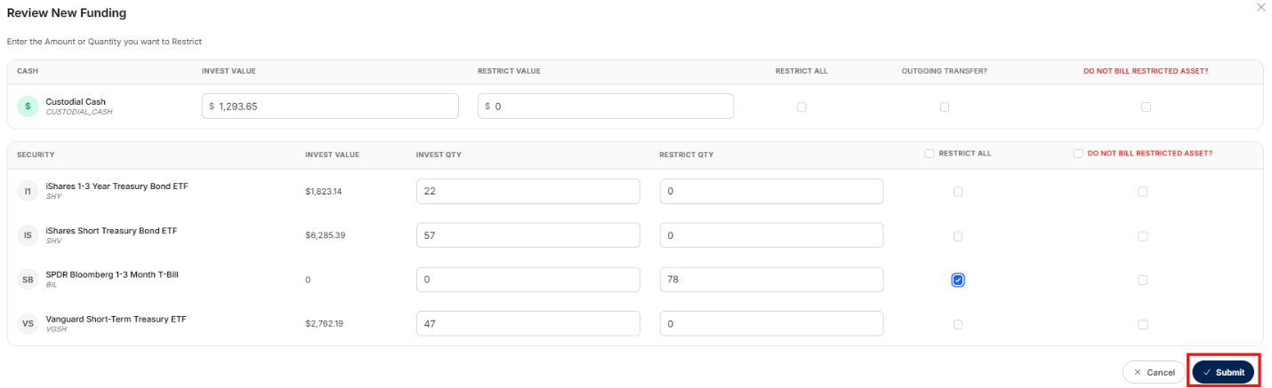
ADVANCED USE CASES
RESTRICTING ASSETS FROM A MODEL
Notes:
Slide 21: Advanced Use Cases: Restricting assets from a model

Slide 31
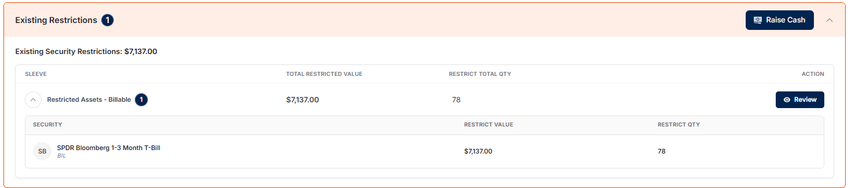
ADVANCED USE CASES
RESTRICTING ASSETS FROM A MODEL
Notes:
Slide 21: Advanced Use Cases: Restricting assets from a model

Slide 32
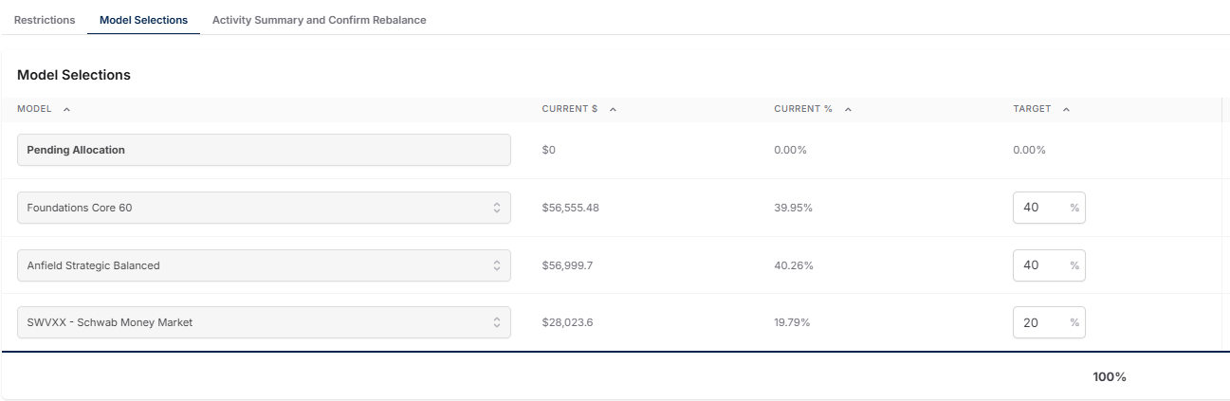
ADVANCED USE CASES
DCA METHODS
Method 1: Using a Target Percentage on SWVXX or FDRXX
Notes:
Slide 22: Advanced Use Cases: DCA Methods

Slide 33
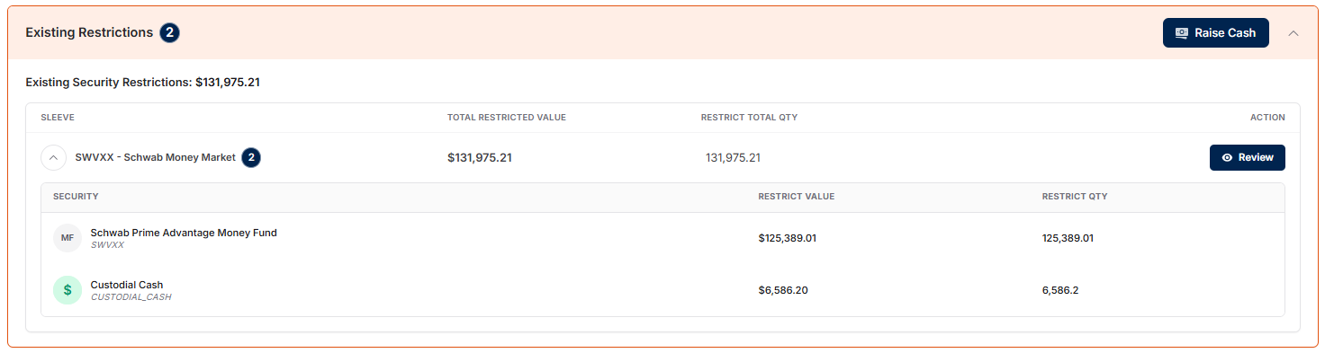
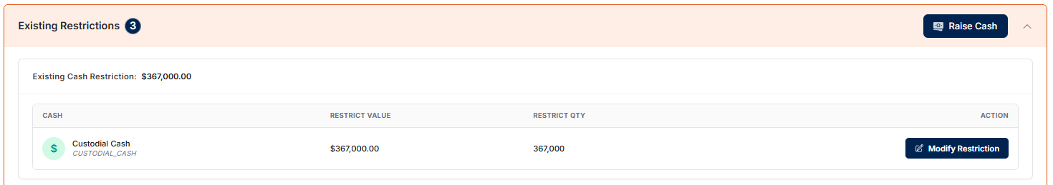
ADVANCED USE CASES
DCA METHODS
Method 2: Unrestricting Assets – Cash or Securities
Calendar Reminder alerts coming soon!
Notes:
Slide 22: Advanced Use Cases: DCA Methods
Calendar reminder alerts coming soon!

Slide 34
2025
NAVIGATING THE PORTAL WITH CONFIDENCE
Tools designed to keep you ahead, not reacting
Underutilized features that make a meaningful difference
Small changes that create consistency at scale
Notes:
Slide 23: Navigating the Portal with Confidence
- Tools designed to keep you ahead, not reacting
- Underutilized features that make a meaningful difference
- Small changes that create consistency at scale

Slide 35
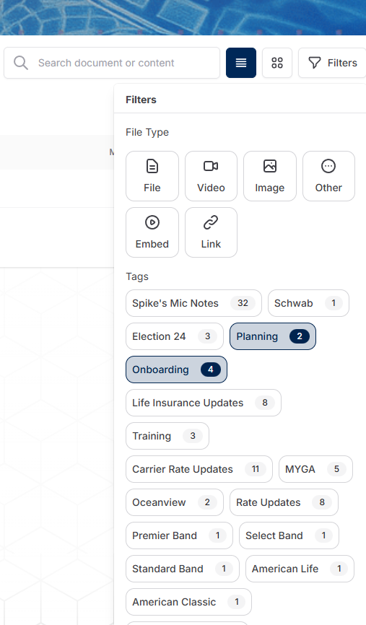
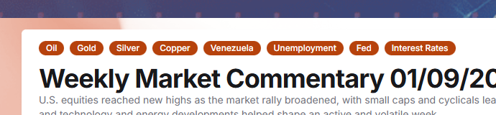
WE HAVE A TAGGING SYSTEM
INFORMATION ORGANIZATION
Notes:
Slide 24: We Have a Tagging System
Information is Organized

Slide 36
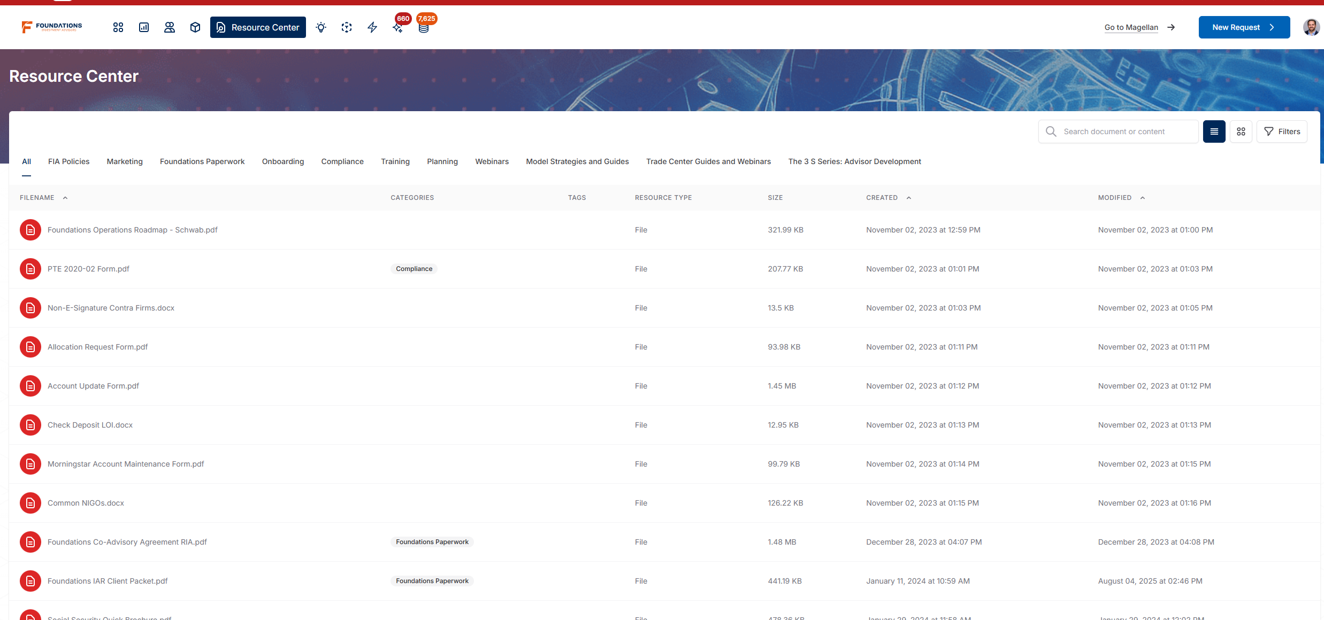
RESOURCE CENTER
ONE PLACE FOR WHAT YOU NEED
Marketing materials
Webinars
Training
Key Resources
Notes:
Slide 25: Resource Center
One Place for What You Need
- Marketing materials
- Webinars and training
- Key advisor resources

Slide 37
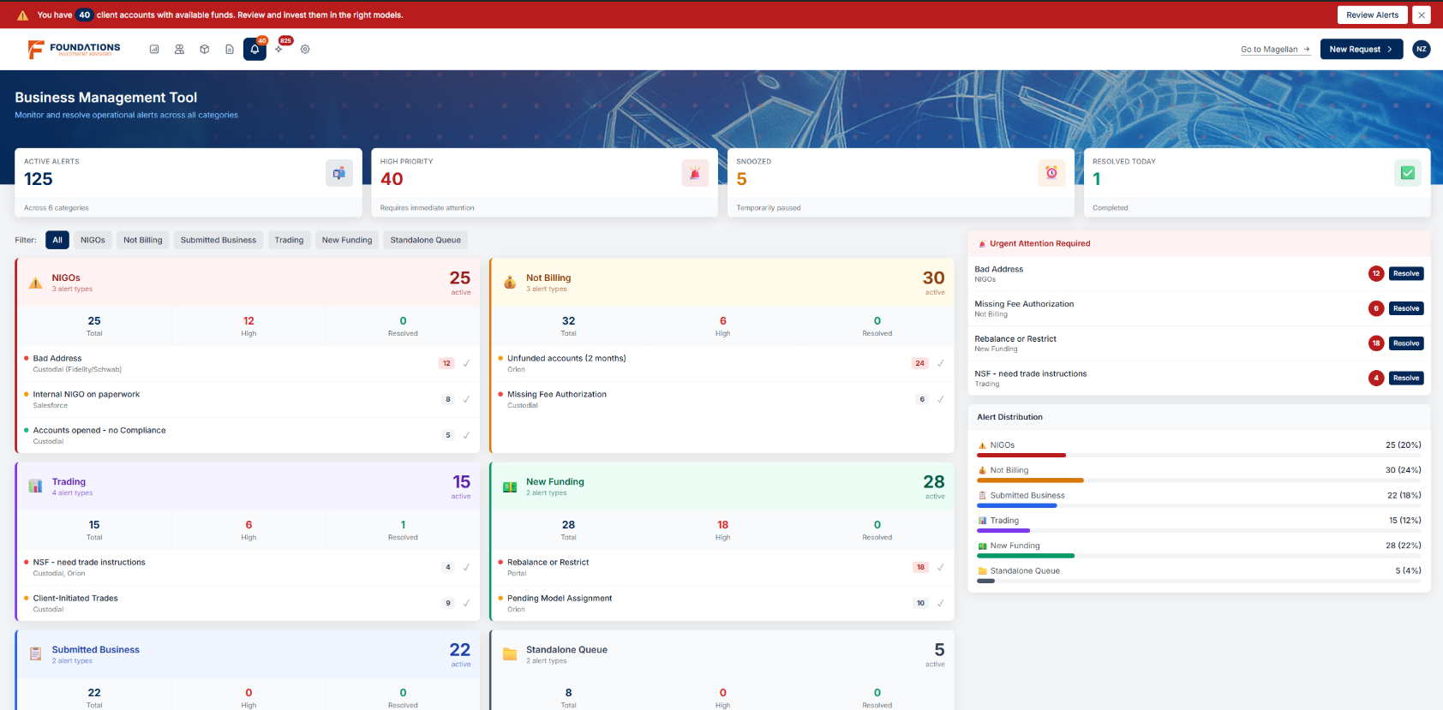
WHAT’S NEXT
THE PHILOSOPHY OF BMT
Business Management Tool
Proactive Tools designed to reduce the back and forth
Centralize visibility into operational gaps
Flag issues before they become bottlenecks
Resolve issues directly within the system
Notes:
Slide 26: What’s Next
The Philosophy of the BMT
-Business Management Tool
Proactive Tools designed to reduce the back and forth
Centralize visibility into operational gaps
Flag issues before they become bottlenecks
Resolve issues directly within the system

Slide 38
2025
BMT CAPABILITIES
Centralized dashboard
Snooze and prioritize alerts
Localized notifications based on how you work
Audit business activity
Notes:
Slide 27: BMT Capabilities
- Centralized dashboard
- Snooze and prioritize alerts
- Localized notifications based on how you work
- Audit business activity

Slide 39
BMT ALERTS
WHAT THE SYSTEM WILL WATCH FOR YOU
Operational Alerts Will Include:
Unfunded accounts for 2+ months
New Funding Not Addressed
Funded accounts waiting on action
Unbilled accounts
Trades Left in Draft
NIGOs
Missing Paperwork
Account Summaries on submitted paperwork
TBD Accounts
Accounts with Insufficient Funds (NSF)
Fewer surprises and cleaner books.
Notes:
Slide 28: BMT Alerts
What the System Will Watch for You
Operational Alerts Will Include:
Billing and Allocation
Unfunded accounts for 2+ months
New Funding Not Addressed
Funded accounts waiting on action
Unbilled accounts
Trades Left in Draft
NIGOs
Missing Paperwork
Account Summaries on Submitted Paperwork
TBD Accounts
Accounts with Insufficient Funds (NSF)
Fewer surprises and cleaner books.

Slide 40
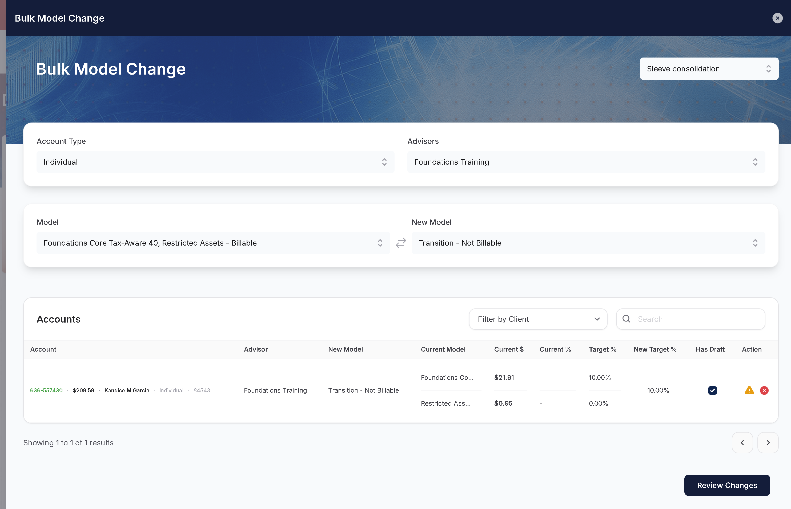
BULK MODEL CHANGE
BUILT FOR SCALE:
Make changes across accounts efficiently
Supports 1:1 and 1:2 changes
Sleeve-level adjustments
Less manual work, more consistency
Bugs Bunny
Notes:
Slide 29: Bulk Model Change
Built for Scale
- Make changes across accounts efficiently
- Supports 1:1 and 1:2 changes
- Sleeve-level adjustments
- Less manual work, more consistency

Slide 41

THE CORE OPERATIONS SUMMIT
2026
QUESTIONS?
Notes:
Slide 30: Q&A

Slide 42
2025
MORE VISION-FORWARD
Systems carry more weight as complexity increases
The Portal is built to support disciplined, scalable operations
Centralized Information and Knowledge
Cleaner Execution
Greater Confidence
Slide
Notes:
Slide 31: More Vision-Forward
- Systems carry more weight as complexity increases
- The Portal is built to support disciplined, scalable operations
- Centralized Information and Knowledge. Cleaner Execution. Greater Confidence.

