Slide 1


THE GREATEST
TRICK
EVER PLAYED
A GUIDE TO TAXES IN RETIREMENT
Information is Current as of January 2026

Slide 2

RETIREMENT: A LOOK BACK
Notes:
There was a time when retirement was a milestone celebrated with a party, cake, a gold watch, and a promise of a stable income. This was a reality before the Revenue Act of 1978.

Slide 3

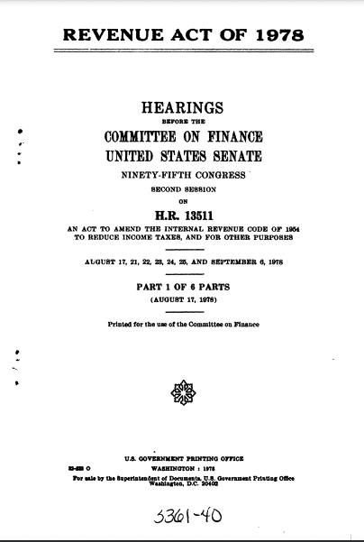
RETIREMENT: A LOOK BACK
There was a time when retirement was a milestone celebrated with a party, cake, a gold watch, and a promise of a stable income.
This was a reality before the Revenue Act of 1978.
Notes:
There was a time when retirement was a milestone celebrated with a party, cake, a gold watch, and a promise of a stable income. This was a reality before the Revenue Act of 1978.

Slide 4

THE PENSION ERA
Notes:
For decades, employees spent their working years at the same company. Upon retirement, they enjoyed the fruits of their labor with a reliable pension check. Employees were loyal to employers and employers took care of their own. Not only were retirees provided with consistent predictable income, they also didn’t have to take on big risks with their investments (possibly show a chart of stock market volume prior to 1978 vs today)

Slide 5
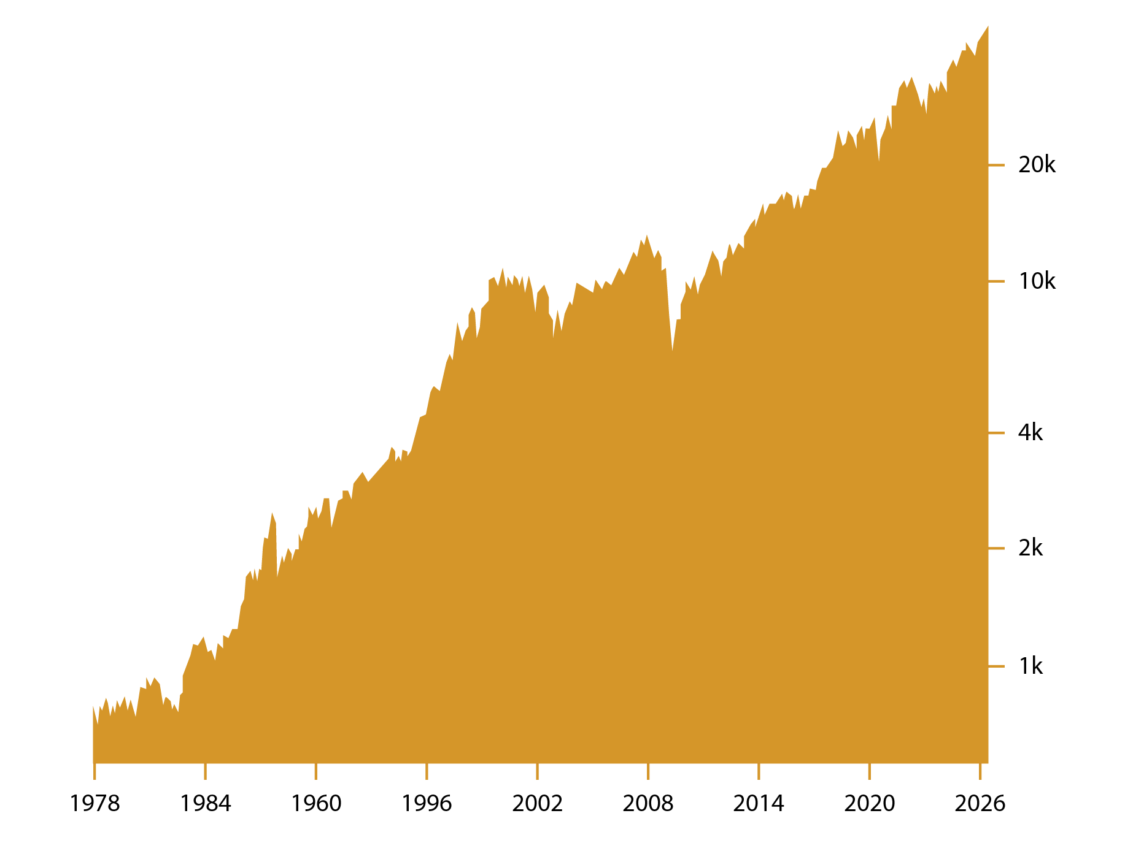
THE GOOD OLD DAYS: PENSIONS & SECURITY
STOCK MARKET VOLUME 1978-2026
For decades, employees spent their working years at the same company.
Upon retirement, they enjoyed the fruits of their labor with a reliable pension check.
Not only were retirees provided with consistent predictable income, they also didn’t have to take on big risks with their investments
Interactive chart generated at Finance.yahoo.com. Finance yahoo is a data aggregator site. Finance.yahoo.com NYSE COMPOSITE (DJ) (^NYA). Accessed January 15, 2026.
Notes:
For decades, employees spent their working years at the same company. Upon retirement, they enjoyed the fruits of their labor with a reliable pension check. Employees were loyal to employers and employers took care of their own. Not only were retirees provided with consistent predictable income, they also didn’t have to take on big risks with their investments (possibly show a chart of stock market volume prior to 1978 vs today)

Slide 6

A SHIFT IN RESPONSIBILITY
Notes:
The Revenue Act of 1978 changed the retirement landscape forever. The immediate impacts were that it shifted the responsibility of retirement from the employer to the employee with the creation of the qualified account (and the phasing out of the pension). Could show the percentage of companies that provided pension income prior to 1978 vs. today. Also allude to the fact that the shift in responsibilities was a big change but there were bigger problems coming that nobody could imagine.

Slide 7
THE SHIFT: FROM EMPLOYER TO EMPLOYEE
PENSION COVERAGE FROM 1980 - 2023
The Revenue Act of 1978 shifted the responsibility of retirement from the employer to the employee with the creation of the qualified account.
Phasing out of pensions.
Source: https://archive.nytimes.com/economix.blogs.nytimes.com/2009/09/03/pensions-1980-vs-today/. Accessed January 15, 2026. https://www.bls.gov/news.release/pdf/ebs2.pdf. Accessed January 15, 2026.
Notes:
The Revenue Act of 1978 changed the retirement landscape forever. The immediate impacts were that it shifted the responsibility of retirement from the employer to the employee with the creation of the qualified account (and the phasing out of the pension). Could show the percentage of companies that provided pension income prior to 1978 vs. today. Also allude to the fact that the shift in responsibilities was a big change but there were bigger problems coming that nobody could imagine.

Slide 8

THE ALLURE OF DEFERRED TAXES
Notes:
When the Revenue Act of 1978 was sold to the public the financial landscape in America was much different. It was the late 1970’s and income tax rates were extremely high and Federal Debt was low. The public was sold a bill of goods that tax rates would be lower in retirement.

Slide 9
DEFERRED TAXES: THE ATTRACTIVE ILLUSION
When the Revenue Act of 1978 was sold to the public the financial landscape in America was much different. It was the late 1970’s and income tax rates were extremely high and Federal Debt was low. The public was sold a bill of goods that tax rates would be lower in retirement.
Notes:
When the Revenue Act of 1978 was sold to the public the financial landscape in America was much different. It was the late 1970’s and income tax rates were extremely high and Federal Debt was low. The public was sold a bill of goods that tax rates would be lower in retirement.

Slide 10

THE GAME IS ALWAYS CHANGING
Notes:
“Fast forward over 40 years, and retirees are playing a complex game with ever changing rules – a game where the rules are made by those who also control spending and federal debt. Remember that bill of goods about deferring taxes now for a lower rate down the road. Lets take an in depth look.

Slide 11

THE COMPLEX GAME OF TAXES IN RETIREMENT
Fast forward over 40 years, and retirees are playing a complex game with ever changing rules
Remember that bill of goods about deferring taxes now for a lower rate down the road.
Notes:
“Fast forward over 40 years, and retirees are playing a complex game with ever changing rules – a game where the rules are made by those who also control spending and federal debt. Remember that bill of goods about deferring taxes now for a lower rate down the road. Lets take an in depth look.

Slide 12

THE RISING TIDE OF FEDERAL DEBT
Notes:
Talk about what Federal debt looked like in 1978 when the rules changed. Total Federal debt was $772 billion which was around 33% of total GDP. Fast Forward to today and Federal debt has exploded. Currently over $30 Trillion in debt which represents 123% of GDP

Slide 13

FEDERAL DEBT
$40 T
$35 T
$30 T
$25 T
$20 T
$15 T
$10 T
$5 T
$0
$38.4 Trillion
1970
1980
1990
2000
2010
2020
2025
https://fiscaldata.treasury.gov/americas-finance-guide/national-debt/. Accessed January 16, 2026.
Notes:
Talk about what Federal debt looked like in 1978 when the rules changed. Total Federal debt was $772 billion which was around 33% of total GDP. Fast Forward to today and Federal debt has exploded. Currently over $30 Trillion in debt which represents 123% of GDP
To put things in perspective, today’s Federal debt stands at over $30 trillion dollars, which is more than 123% of GDP. This substantial increase in debt poses significant implications for future tax policy and retirement planning.

Slide 14

A HISTORY OF TAX RATES
Notes:
We just looked at Federal debt/spending over time. Now let’s take a look at the highest marginal tax rates over time.

Slide 15
TAX RATES THROUGH THE DECADES
100%
80%
60%
40%
20%
0%
37%
1920
1930
1940
1950
1960
1970
1980
1990
2000
2010
2020
2026
https://www.taxpolicycenter.org/statistics/historical-highest-marginal-income-tax-rates. Accessed January 15, 2026.
Notes:
We just looked at Federal debt/spending over time. Now let’s take a look at the highest marginal tax rates over time.

Slide 16

TAX RATES AND FEDERAL DEBT:
IS THERE A CORRELATION?
Notes:
While past performance is not indicative of future results, history offers valuable insights. With Federal debt soaring, what might that imply for future tax rates? Possibly get audience engagement here….ask for opinions. Slides here serve to graphically illustrate the magnitude of change in Federal debt and to allow pre-retirees and retirees to visually grasp the potential for shifts in tax policy.

Slide 17
TAX RATES AND FEDERAL DEBT
TAX RATES
FEDERAL DEBT
38.4 Trillion
1920
1930
1940
1950
1960
1970
1980
1990
2000
2010
2020
2026
Source: https://www.taxpolicycenter.org/statistics/historical-highest-marginal-income-tax-rates. Accessed January 15, 2026
https://fiscaldata.treasury.gov/americas-finance-guide/national-debt/. Accessed January 15, 2026.
.
Notes:
While past performance is not indicative of future results, history offers valuable insights. With Federal debt soaring, what might that imply for future tax rates? Possibly get audience engagement here….ask for opinions. Slides here serve to graphically illustrate the magnitude of change in Federal debt and to allow pre-retirees and retirees to visually grasp the potential for shifts in tax policy.

Slide 18

RISING INTEREST RATES:
THE GROWING BURDEN OF FEDERAL DEBT
Notes:
As interest rates increase, so does the cost of servicing the Federal debt. Higher interest rates mean the government will need to allocate more of its budget to interest payments, leaving less available for other expenses.”

Slide 19
RISING INTEREST RATES
As interest rates increase, so does the cost of servicing the Federal debt.
Higher interest rates mean the government will need to allocate more of its budget to interest payments, leaving less available for other expenses.
Notes:
As interest rates increase, so does the cost of servicing the Federal debt. Higher interest rates mean the government will need to allocate more of its budget to interest payments, leaving less available for other expenses.”

Slide 20

THE COST OF DEBT SERVICING
Notes:
The cost of debt servicing is becoming an increasing significant portion of the federal budget. The pressure may lead to reduced funding for government programs or could drive a need for increased tax revenue.

Slide 21
INTEREST PAYMENTS
The cost of debt servicing is becoming an increasingly significant portion of the federal budget.
The pressure may lead to reduced funding for government programs or could drive a need for increased tax revenue.
$1 Trillion
https://fiscaldata.treasury.gov/americas-finance-guide/national-debt/ Accessed January 15, 2026.
Notes:
The cost of debt servicing is becoming an increasing significant portion of the federal budget. The pressure may lead to reduced funding for government programs or could drive a need for increased tax revenue.

Slide 22

BALANCING ACT:
TAX POLICY AND DEBT INTEREST
Notes:
As the government juggles rising interest payments, it may be compelled to modify tax policies to manage the financial strain. This could lead to an environment of higher taxation to balance the budget, potentially impacting taxpayers.

Slide 23
BALANCING ACT
As the government juggles rising interest payments, it may be compelled to modify tax policies to manage the financial strain.
Notes:
As the government juggles rising interest payments, it may be compelled to modify tax policies to manage the financial strain. This could lead to an environment of higher taxation to balance the budget, potentially impacting taxpayers.

Slide 24

PLANNING: TAXES & UNCERTAINTY
Notes:
In an era of rising interest rates and federal debt, it’s essential to prepare for the uncertainty in tax policy. Diversifying your income and utilizing tax-advantaged strategies can help safeguard your retirement against the shifting financial landscape. This section should educate the audience on the implications of rising interest rates in the context of federal debt and how it might directly impact them through changes in tax policy. In this section maybe we show what the impact of a higher tax rate would be vs today’s tax rates on the lump sum they have in qualified accounts.

Slide 25
TAXES & UNCERTAINTY
In an era of rising interest rates and federal debt, it’s essential to prepare for the uncertainty in tax policy.
Diversifying your income and utilizing tax-advantaged strategies can help safeguard your retirement against the shifting financial landscape.
Even though OBBBA made today’s lower tax brackets permanent, rising federal debt and changing economic conditions mean future tax increases remain possible. Strategic planning, like Roth conversions, can help prepare for these uncertainties.
Under OBBBA, new deductions like the Senior Deduction and SALT deduction phaseouts mean retirees must carefully consider how Roth conversions affect their taxable income thresholds.
Notes:
In an era of rising interest rates and federal debt, it’s essential to prepare for the uncertainty in tax policy. Diversifying your income and utilizing tax-advantaged strategies can help safeguard your retirement against the shifting financial landscape. This section should educate the audience on the implications of rising interest rates in the context of federal debt and how it might directly impact them through changes in tax policy. In this section maybe we show what the impact of a higher tax rate would be vs today’s tax rates on the lump sum they have in qualified accounts.

Slide 26


THE GOOD NEWS:
OUR CURRENT TAX WINDOW
Notes:
Today we are in one of the most advantageous tax windows in history. But the Window is set to close a the end of 2025. What can you do now to maximize your retirement?

Slide 27
THE CLOSING WINDOW
1
2
3
DO NOTHING
Continue to defer and pay unknown taxes later
PAY TAXES NOW
Known rates vs unknown
TAX EFFICIENT PLANNING OPTIONS
Contribute to Roth
Covert traditional IRA to Roth IRA
Take advantage of Living Benefits plans
Tax Code Section 7702
Notes:
Today we are in one of the most advantageous tax environments in history, with lower rates made permanent under the One Big Beautiful Bill Act (OBBBA). While there is no longer a set expiration date for these rates, future tax law changes remain possible. What steps can you take now to take advantage of today’s favorable rates while planning for potential changes ahead?

Slide 28

ROTH IRAS:
TAX-FREE RETIREMENT INCOME
Notes:
Roth IRAs offer a tax-free income in retirement, allowing you to grow your savings without worrying of future tax rates. Pay the taxes now and gains are tax free. Elude to the fact that the earlier you start these the better off you are.

Slide 29
ROTH IRAS
For illustrative purposes only. The results presented above do not represent any actual investment performance or the actual accounts of any investors. Chart assumes 8% hypothetical average rate of return over a 20-year time frame and does not factor inflation.
$4,315,701
$2,815,882
Notes:
Roth IRAs offer a tax-free income in retirement, allowing you to grow your savings without worrying of future tax rates. Pay the taxes now and gains are tax free. Elude to the fact that the earlier you start these the better off you are.

Slide 30

ROTH CONVERSIONS:
LOCKING IN TODAY’S LOW RATES
Notes:
Based on market conditions and current tax rates, today might be a great time to do a Roth conversion. The tradeoff is paying taxes today at a known rate and receiving tax free growth. This could save you a lot of money in the long run and provide a more comfortable retirement.

Slide 31
ROTH CONVERSIONS
Conversion Rules
No income limits or phase out (higher income earners may be able to convert but not contribute)
Taxes paid in tax year for conversion (partial conversions are allowed)
May increase effective tax rates, especially with interactions of new deductions under OBBBA
No age limit to convert
Potential Tax Advantages
No income tax is due on future earnings or withdrawals
Does not count towards tax on Social Security Benefits
Under OBBBA, today’s lower tax brackets are now permanent, removing the 2025 expiration concern
Conversions can help lock in these favorable rates while providing flexibility against possible future tax law changes
Notes:
Based on market conditions and current tax rates, today might be a great time to do a Roth conversion. The tradeoff is paying taxes today at a known rate and receiving tax free growth. This could save you a lot of money in the long run and provide a more comfortable retirement.

Slide 32

SECTION 7702 PLANS:
A TAX-EFFICIENT STRATEGY
Notes:
talk about how to most people “life insurance” is a bad word. Most think you have to pass away for anyone to see the benefits of it. Talk about how life insurance policies under tax section 7702 can offer another avenue to accumulate cash value on a tax-advantage basis. Can talk about the other living benefits of life insurance.

Slide 33

SECTION 7702 PLANS
Notes:
talk about how to most people “life insurance” is a bad word. Most think you have to pass away for anyone to see the benefits of it. Talk about how life insurance policies under tax section 7702 can offer another avenue to accumulate cash value on a tax-advantage basis. Can talk about the other living benefits of life insurance.

Slide 34

DIVERSIFY AND CONQUER:
A MULTI-FACETED APPROACH
Notes:
Talk about the other ways to reduce taxes in retirement. From having HSA to strategic ways to WD money from retirement accounts.

Slide 35

TAX REDUCTION STRATEGIES
Contributions to tax-advantaged accounts
RMD Planning
Health Savings Accounts
Timing of Social Security Benefits
Roth Conversions
Staying Informed about tax-law changes
Notes:
Talk about the other ways to reduce taxes in retirement. From having HSA to strategic ways to WD money from retirement accounts.

Slide 36

YOUR PATH TO A TAX-EFFICIENT RETIREMENT
Notes:
The great thing about the impact taxes will have on your retirement is you can have a direct impact on your own plan. The bad news is if you don’t take action the Government will ha plan for you. One you probably won’t like.

Slide 37
THANK YOU!
000.000.0000
WebsiteURL.com
QR CODE
Address Line #1 Address Line #2

Slide 38
Investment advisory services offered through Foundations Investment Advisors, LLC (“Foundations”), an SEC registered investment adviser. The content provided is intended for informational and educational purposes only. The views, statements and opinions expressed herein are those of the individual speaker(s) and not necessarily those of Foundations and its affiliates.The content herein is subject to change without notice. A Roth conversion may not be suitable for your situation. The primary goal in converting retirement assets into a Roth IRA is to reduce the future tax liability on the distributions you take in retirement, or on the distributions of your beneficiaries. The information provided is to help you determine whether or not a Roth IRA conversion may be appropriate for your particular circumstances. Nothing in this presentation constitutes legal, tax or investment advice or an offer to sell any securities or represent an express or implied opinion or endorsement of any specific investment opportunity, offering or issuer. Each individual investor’s situation is different, and any ideas provided may not be appropriate for your particular circumstances. Personal investment advice can only be rendered after the engagement of Foundations, execution of required documentation, and receipt of required disclosures. Investments in securities involve the risk of loss. Any past performance is no guarantee of future results. Advisory services are only offered to clients or prospective clients where Foundations and its advisors are properly licensed or exempted. Foundations deems reliable any statistical data or information obtained from or prepared by third party sources included in this presentation, but in no way guarantees its accuracy or completeness.

